Slide 1
Phone Book Application
Done by: Hassan Mahmood and Alissa Nonato

Slide 2
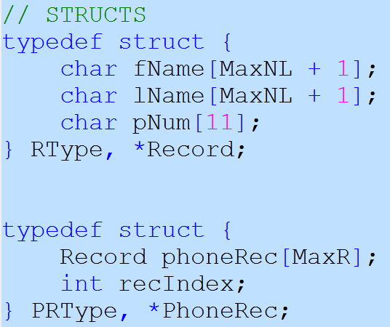
Data Structures Used
Two structs – Record and PhoneRec
Why we chose this structure

Slide 3
Complexities
 | Worst Case | Average Case | Best Case
Add | O(n) | O(n) | O(n)
Retrieve | O(n) | O(n) | O(n)
Delete | O(n²) | O(n²) | O(n)
Load | O(n) | O(n) | O(n)
Save | O(n) | O(n) | O(n)
Sort | O(n²) | O(nlogn) | O(nlogn)

